Slide 1
August 24th 2023
50/30/20 variance split with better PCA method
Gaussian mixture model on normal images
Analysis with fixed kernel centers

Slide 2
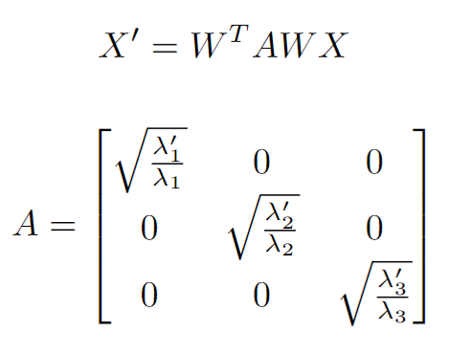
Changing color PCs eigenvalues

Slide 3
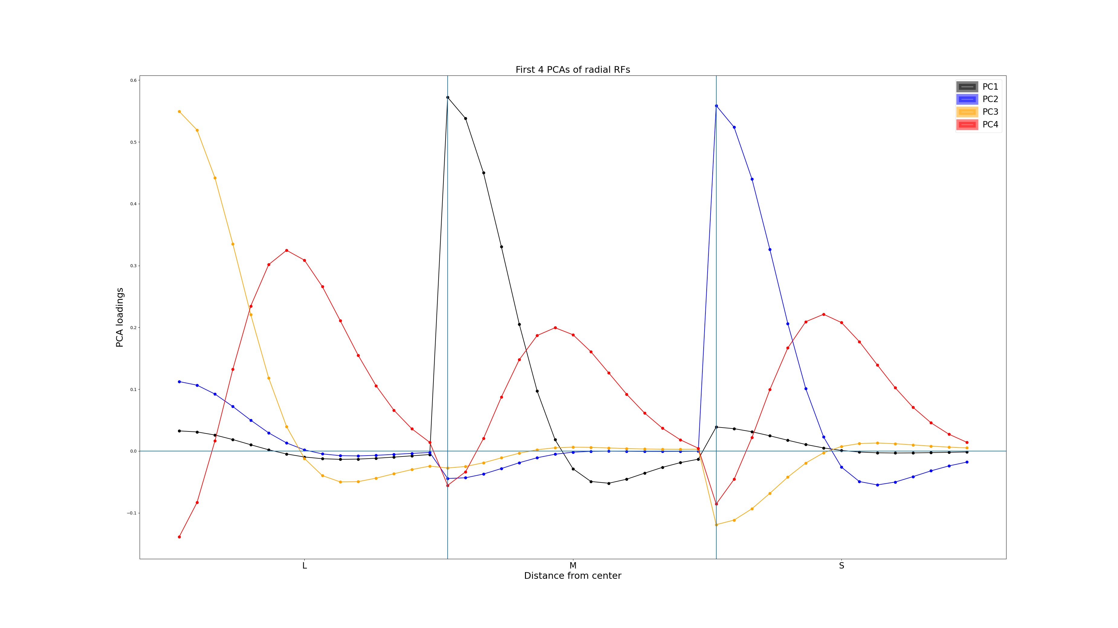

Slide 4
Gaussian mixture model on original images
Show video

Slide 5
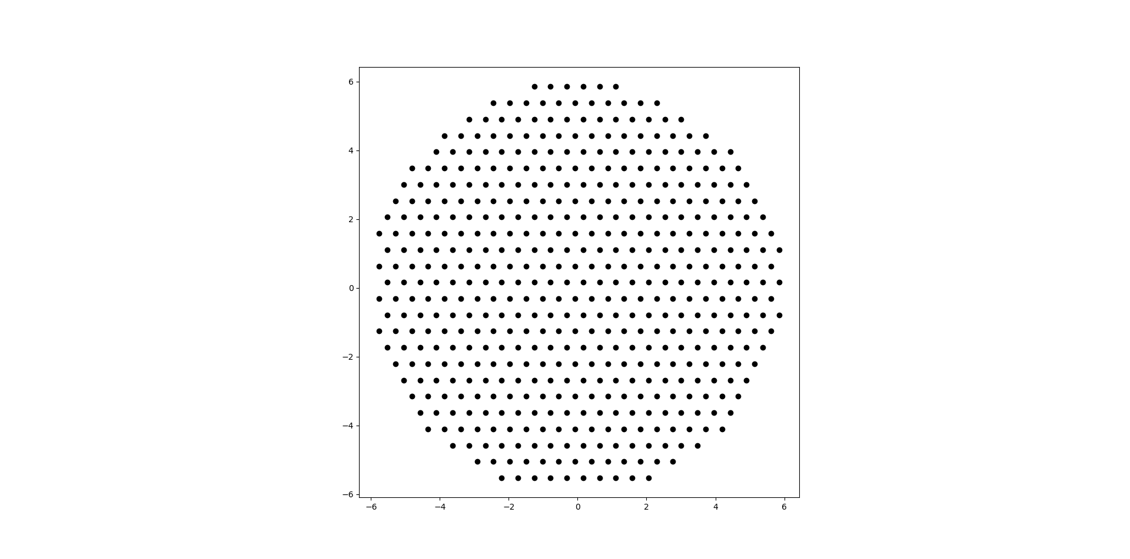
What if we fix kernel centers?

Slide 6
Preliminary results
I would show you the results but I just realized there’s a bug

Slide 7
Different color split
Current color split
Black/white: 94.7%
Blue/yellow: 5.13%
Red/green: 0.17%
How about boosting red/green 10x, from 0.17% to 1.7% ?
80/15/5

